Slide 1
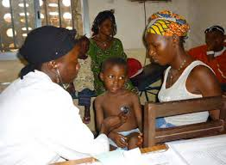
Linking to care: mediating & monitoring role patient association
Experience in Conakry, Guinea (April 2014):
For some health facilities no direct initiation possible at testing site > referral to ARV site with known treatment slots
Members of patient associations accompany PLHIV to ART site and check if problem to enroll.
After 1-2 weeks patient associations contact per phone PLHIV identified and refered to Health facilities in town and enquire what happened after reference.
Relatively simple reporting tool – per health facility – per person explanation
Results

Slide 2
Additional information: * Patients required to pay for CD4 and biochemic lab tests before initiation (50-150.000 Fguin); without it no start ARV * Some health facilities less motivated - Some health facilities important numbers * Limitations: some patients couldn’t be joined (left Conakry) * 6 deaths while on waiting list * Report to health facilities and supervisors. Repeat to check improvement
April 2014 | HF 1 | HF2 | HF3 | HF4 | HF5 | HF6 | HF7 | Total
Number patients referred | 67 | 29 | 17 | 15 | 6 | 0 | 0 | 134
Number patients no access to ARV-site | 1 | 0 | 0 | 0 | 0 | 0 | 0 | 1
Number initiated on ARV after 2 weeks | 30 | 10 | 14 | 9 | 5 | 0 | 0 | 68
Number not initiated | 36 | 19 | 3 | 6 | 1 | 0 | 0 | 65

